Slide 1
Know Your Hardware: CPU Memory Hierarchy
Alexander Titov

Slide 2



About me
Alexander Titov
CPU Hardware Architect
10 years of C++ experience (CPU simulation)
Teaching Computer Architecture and Design
alexander.titov@atitov.com
alexander-titov-cpu

Slide 3
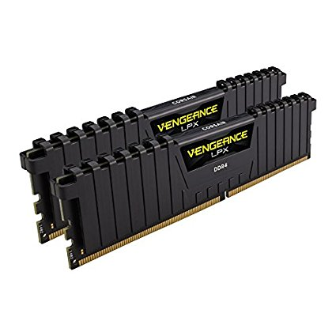
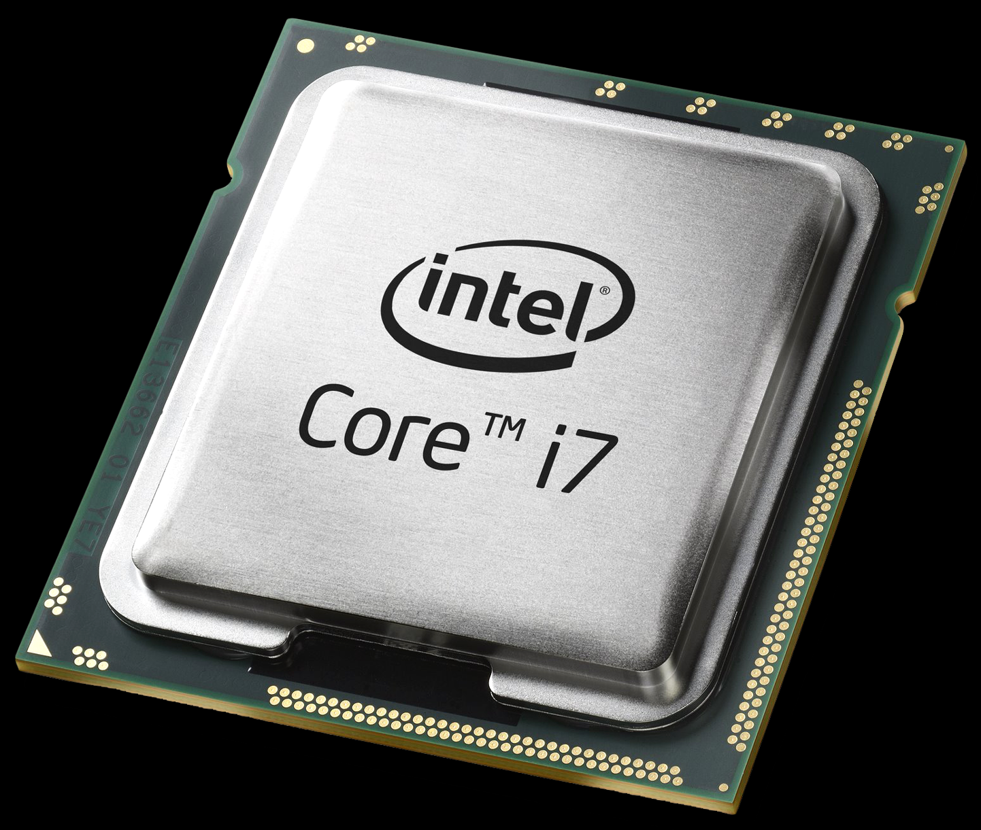
How CPU Works?
Outside World
Outside Memory
CPU

Slide 4
How CPU Works?
?
Simplified CPU actions:
2
3
a[0] = b[0] + 1
a[0] =
what next?
what to do?
010100…0101
from MEM
Read instruction
Decode it
Read inputs
Execute instruction
Write result
Read next instruction
Decode it
Read inputs
from MEM
to MEM
Outside Memory
CPU
Conclusion: CPU works a lot with Outside Memory

Slide 5
Is Outside Memory Fast?
Outside Memory
CPU
CPU

Slide 6
Is Outside Memory Fast?
– No
4x
~100 ns
~0.5 ns
Outside Memory
CPU
Memory is very slow.
CPU would wait 99% of the time for Memory response.

Slide 7
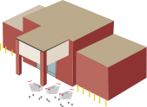

Cache Hierarchy
~30 ns
~100 ns
~10 ns
~0.5 ns
~3 ns
Cache
3rd
level
Cache
2nd
level
Cache
1st level
32 KB
Outside Memory
256 KB – 1 MB
CPU
10 – 30 MB
10 GB – 1 TB

Slide 8
Cache Hierarchy In Action
~30 ns
~100 ns
~10 ns
~0.5 ns
~3 ns
miss
miss
miss
32 KB
Outside Memory
256 KB – 1 MB
CPU
10 – 30 MB
10 GB – 1 TB

Slide 9
Cache Hierarchy In Action
~30 ns
~100 ns
~10 ns
~0.5 ns
~3 ns
hit
32 KB
Outside Memory
256 KB – 1 MB
CPU
10 – 30 MB
10 GB – 1 TB
Locality principle:
the same data is requested several times in a short period of time

Slide 10
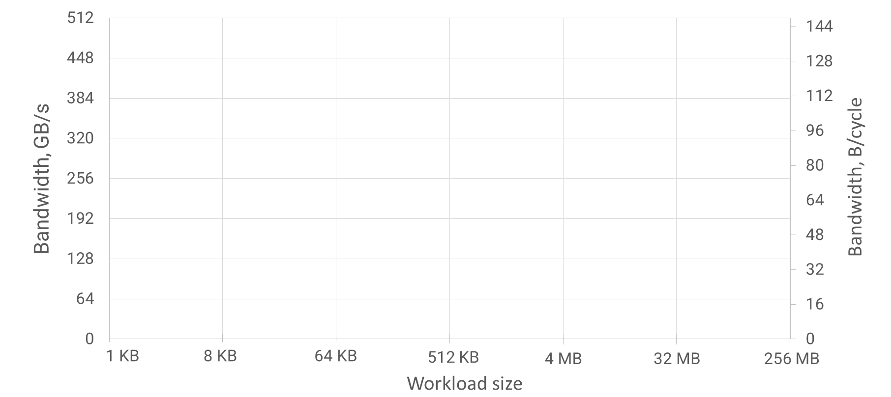
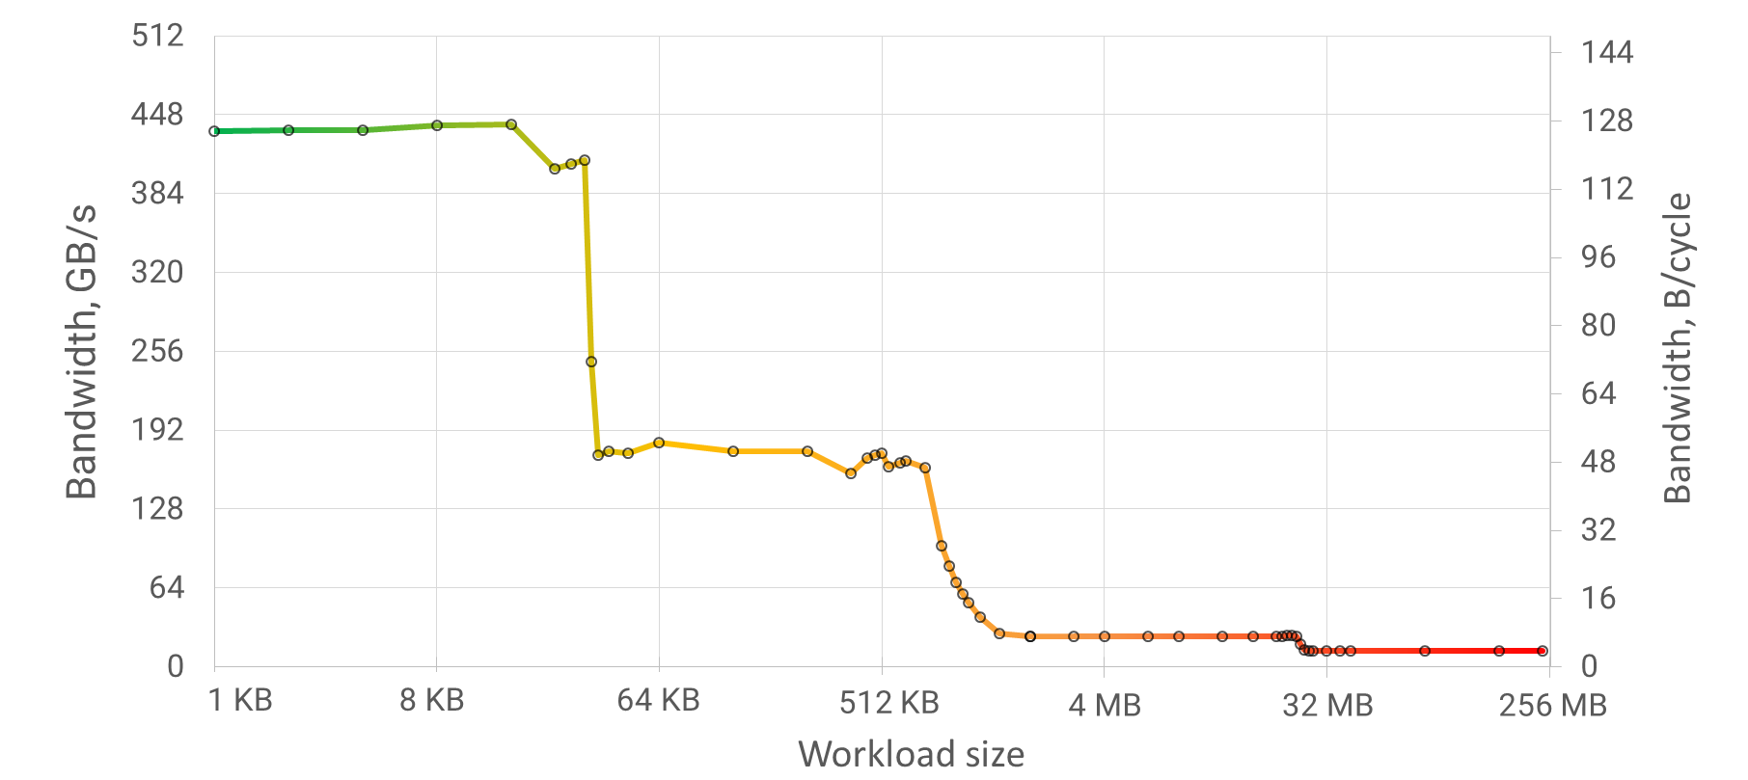
Experiment: Defining Cache Hierarchy
Intel(R) Xeon(R) Gold 6130 CPU, TDP 2.10GHz, Turbo 3.77Ghz
32 KB
1 MB
22 MB
L1 Cache
32 KB
L2 Cache
1MB
L3 Cache
22MB
Outside
Memory
430 GB/s
128 B/cycle
intuition
170 GB/s
50 B/cycle
25 GB/s
7 B/cycle
13 GB/s
3 B/cycle

Slide 11
Performance Optimizations
Rule #1:
Use tools: google benchmark, perf, Intel VTune Amplifier, etc.
Rule #2: Do educated decisions
Rule #3: Do not reinvent bicycle
For many tasks there are highly optimized libraries (e.g., Intel MKL)
Rule #4: Optimize in the following order
General algorithm (e.g., O(NlogN) vs. O(N^2))
Memory allocation, copy vs. move, etc.
Data structures organization in memory and access patterns
Branches, code footprint
…
Measure it!

Slide 12
Tip: Divide and Conquer
Split large workload in parts that fit in the cache
→ improve locality
cache size
Large workload
Split workload

Slide 13
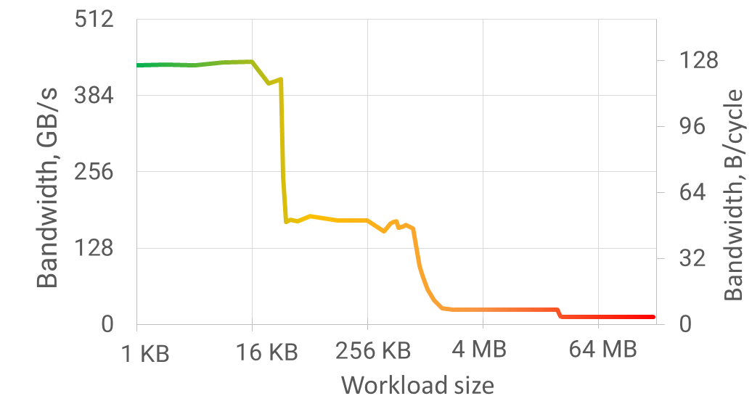
Tip: Divide and Conquer
Split large workload in parts that fit in the cache
→ improve locality
Example:
64 MB x 1000 times
→ 4096 parts x (16 KB x 1000 times)
cache size
30x
speedup
Large workload
Split workload

Slide 14
Tip: Split Warm and Cold Data
All data transfers are performed in aligned chunks of 64 B (line)
Even if 1B is requested by instruction, the whole 64B chunk is read
If the rest of the line is not used, it occupies space and BW in vain
Extract fields that are accessed more often (warm) into a separate object

Slide 15
Tip: Split Warm and Cold Data
Extract fields that are accessed more often (warm) into a separate object
struct Mixed {
int warm;
int cold[15];
};
Mixed mixed_array[N];
struct Warm {
int warm;
};
Warm warm_array[N];
Cold cold_array[N];
struct Cold {
int cold[15];
};
0
64
128
0
64
128
6% efficiency
100% efficiency
Decrease occupied cache space and memory bandwidth by 16x times!

Slide 16

Tip: Dense Data Packing
By default, C++ has sparse data packing
Each field is aligned by its size (to prevent line splits)
#pragma pack(push)
#pragma pack(1)
struct Dense {
bool b0;
int i;
bool b1;
double d;
};
#pragma pack(pop)
struct Sparse {
bool b0;
int i;
bool b1;
double d;
};
struct LessSparse {
bool b0;
bool b1;
int i;
double d;
};
struct _Sparse {
bool b0;
uint8_t padding0[3];
int i;
bool b1;
uint8_t padding0[7];
double d;
};
// 1B
// 4B
// 1B
// 8B
24
sizeof(Sparse) ==
?
sizeof(LessSparse) ==
16
sizeof(Dense) ==
14
b0
i
b1
d
b0
b1
i
d
b0
i
b1
d

Slide 17
Pitfall: Split Atomic
Dense packing can be dangerous. E.g., lead to split line atomics.
#pragma pack(push)
#pragma pack(1)
struct alignas(64) SplitAtomic
{
uint8_t padding[63];
atomic<uint64_t> a;
};
#pragma pack(pop)
struct alignas(64) Atomic
{
uint8_t padding[63];
atomic<uint64_t> a;
};
vs.
0
64
128
0
64
128
padding
a
padding
a
atomic is in two lines
A split line atomic is ~300x slower that an usual atomic!

Slide 18
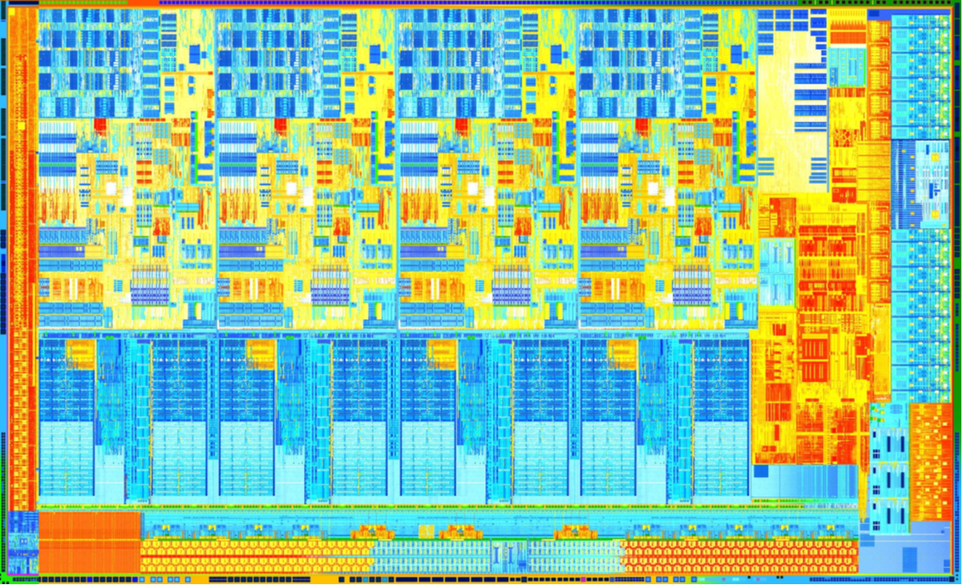
Pitfall: False Line Sharing
Do not place independent data written by multiple threads into one line!
If data is only read → OK
Example:
Core
Core
Core
Core
// each thread repeatedly writes
// only its own element
int thread_results[4];
want to write
System Agent
&
Memory Controller
snoop
0
64
snoop
snoop
Core must “own” a whole line to be able to write it
The copies in the other Cores are removed
snoop
Each write miss L1 and L2 caches!
If the data were in different lines, it would be L1 hits
Shared L3 Cache

Slide 19
What Next?
Docs:
Intel Architectures Optimization Reference Manual
Courses:
High-Performance Computing and Concurrency by Fedor G. Pikus
Tools:
Google Benchmark
godbolt.org / quick-bench.com
Intel VTune Amplifier

Slide 20
Many thanks!
Questions welcome :)
Alexander Titov
alexander.titov@atitov.com
alexander-titov-cpu

